Slide 1
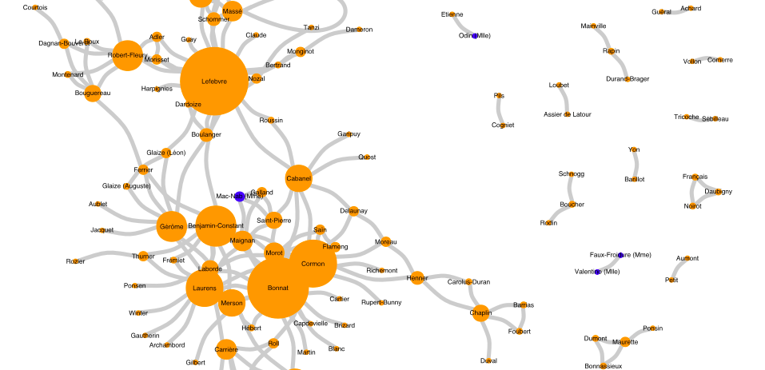
Network Analysis
with R (and beyond!)
NA+DAH, April 14, 2021
A Getty Advanced Workshop on
Network Analysis and Digital Art History
Léa Saint-Raymond (ENS-PSL)

Slide 2

What do you want to do ?
Compute statistics
Go fast
Draw beautiful networks (for publication)
Overlay a network on a map

Slide 3
What do you want to do ?
Compute statistics
Go fast
Use R
Draw beautiful networks (for publication)
(it depends on the map!)
Overlay a network on a map

Slide 5
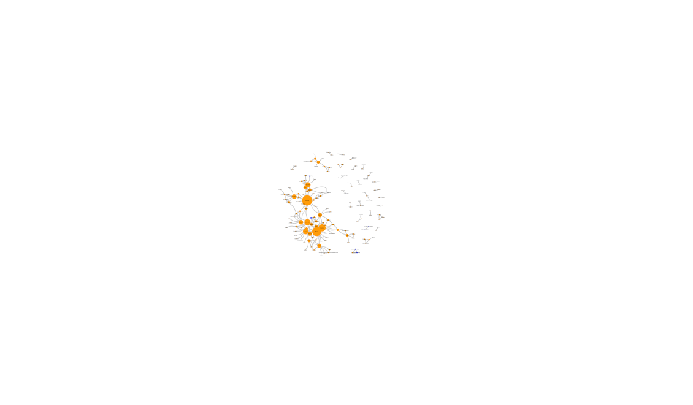

Slide 6
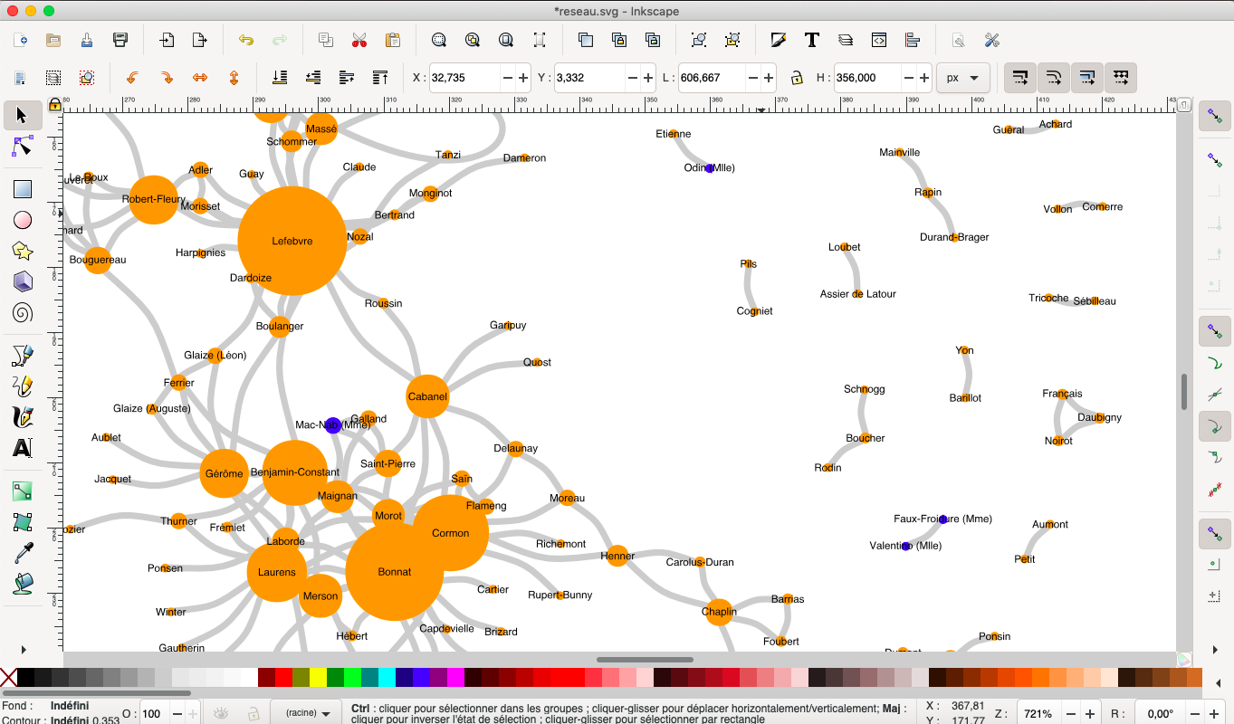

Slide 7
What do you want to do ?
Compute statistics
Go fast
Use
Gephi
Draw beautiful networks (for publication)
Overlay a network on a map

Slide 8
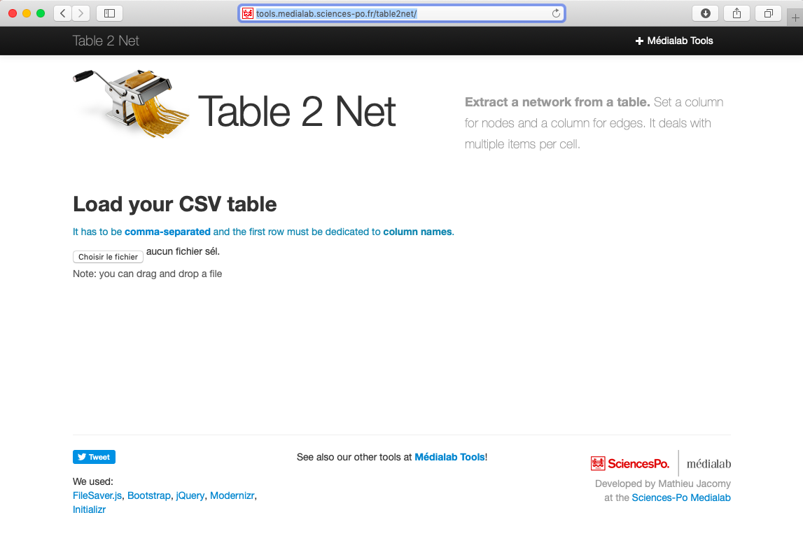
Prepare your input file with https://medialab.github.io/table2net/

Slide 9
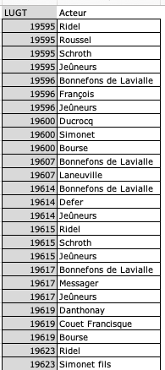
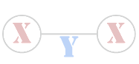
Option #1 : normal network.
I want a single type of nodes, for instance art market actors. They will be linked when they share a value in another column, for instance Lugt number.

Slide 10
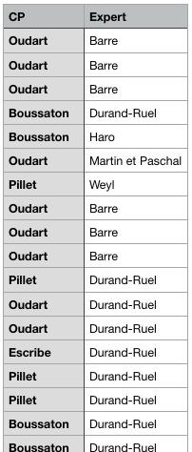

Option #2 : bipartite network.
I want two types of nodes, for instance auctioneers (CP) and experts. So column1 = CP and column 2 = experts.
Experts and CP will be linked if they appear in the same row of the table

Slide 11
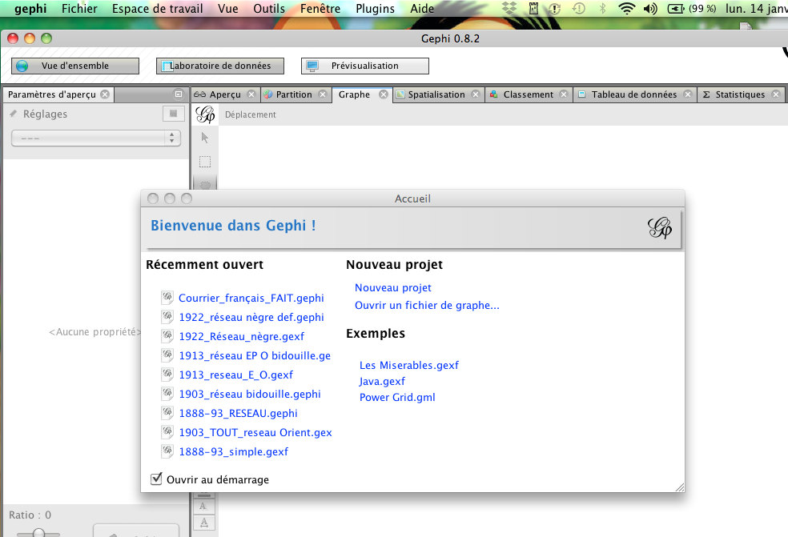
Open the gexf file

Slide 12
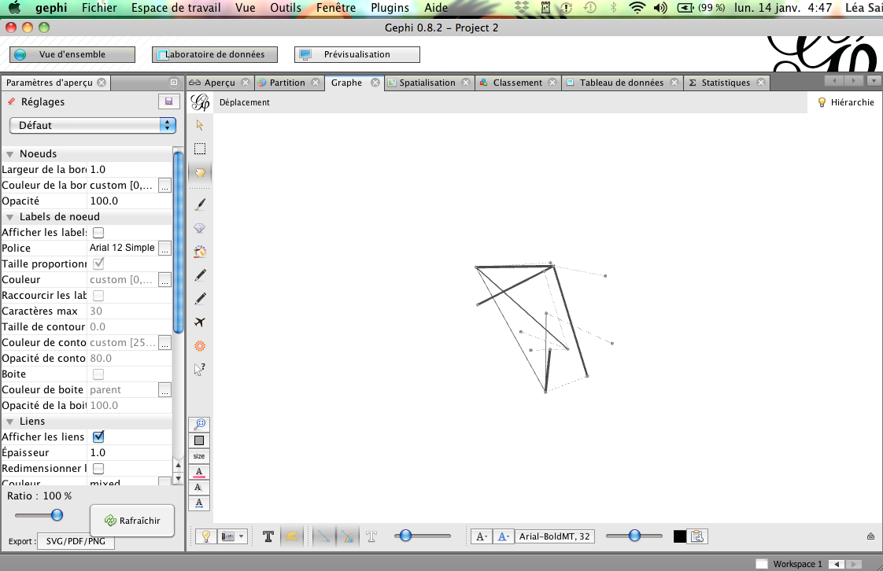
The « Vue d’ensemble » window allows to modify the shape of the network.

Slide 13
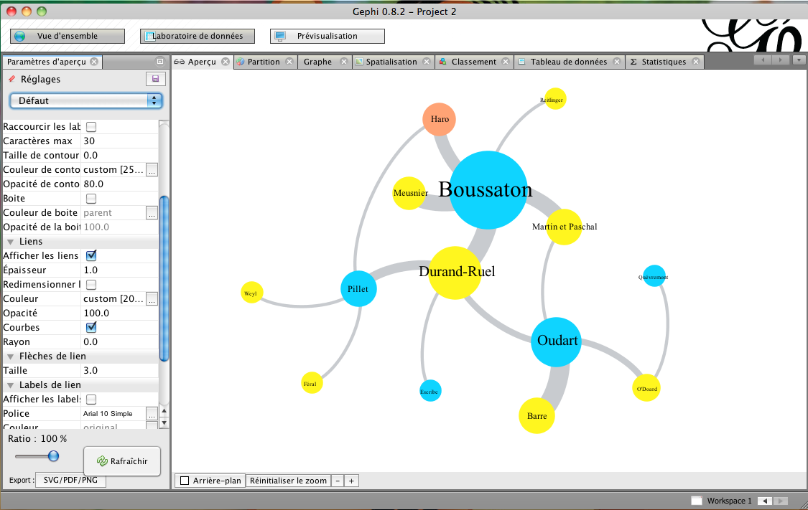
The « prévisualisation » window allows to improve the network.

Slide 14
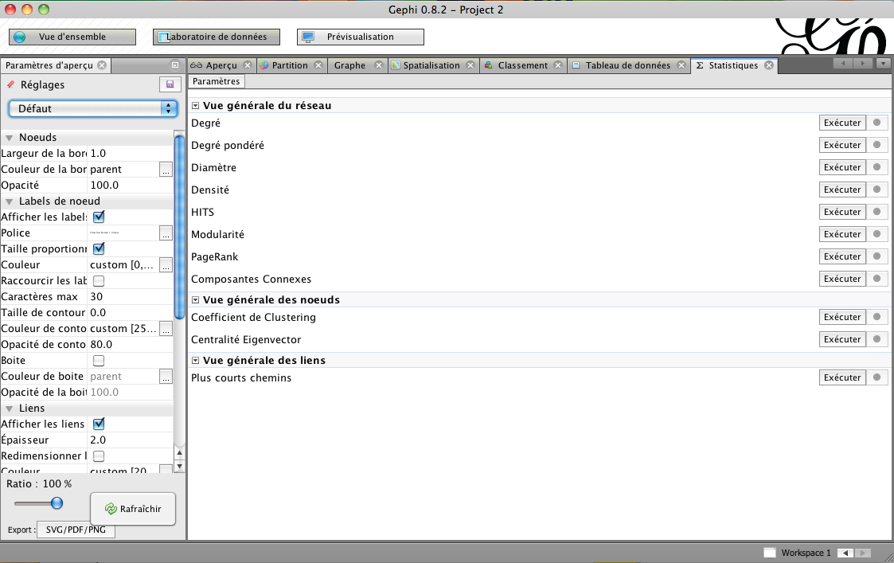
The « statistiques » window allows to compute the statistics of the network

Slide 15
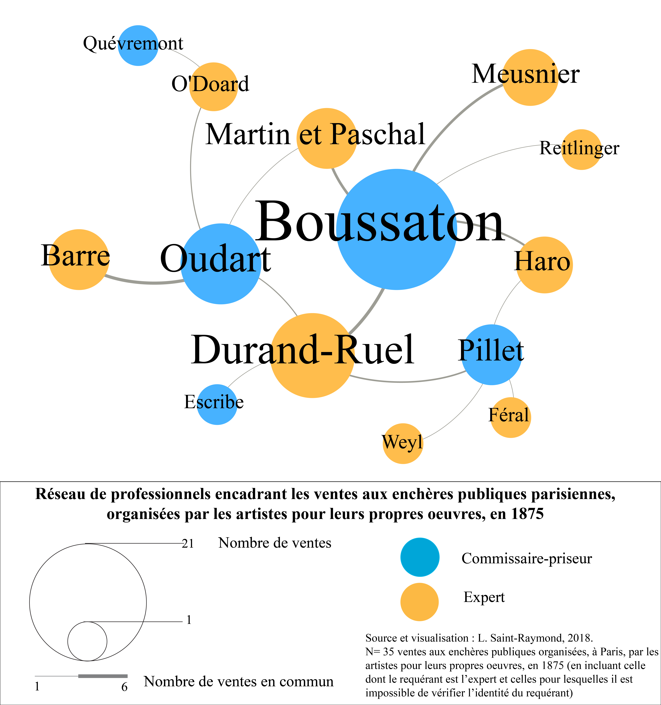
Export as a svg file and add the legend with Inkscape

Slide 16
Network visualization is always a trade-off between comprehensiveness and readability.

Slide 17

What is a « good » corpus?

Slide 18
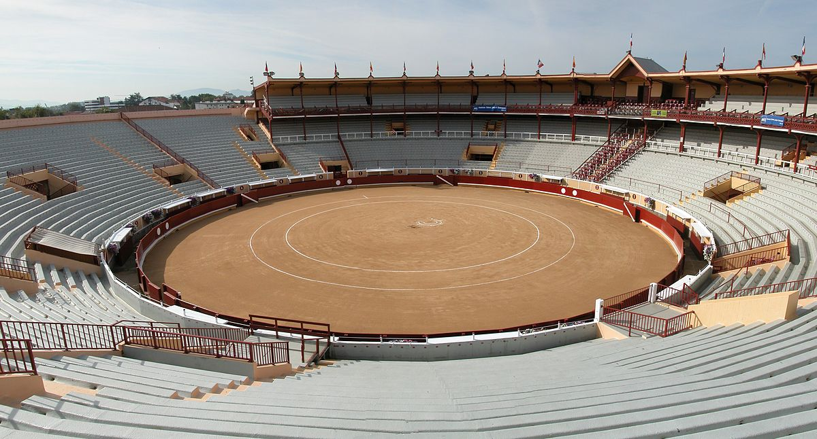
For reasons of time, feasibility and significance of the results, it is better to have a closed corpus, whose limits are known.

Slide 19
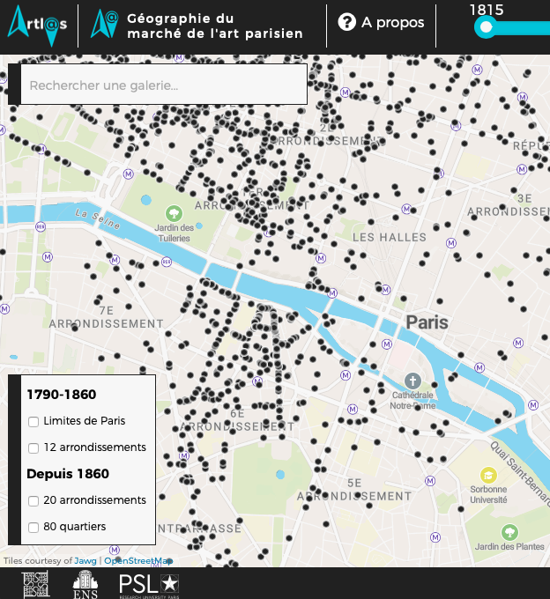
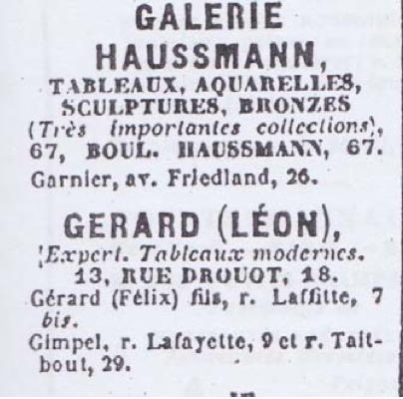
Some examples:
With Julien Cavero and Félicie de Maupeou : picture dealers in the
Bottin du commerce (1815-1955)
https://paris-art-market.huma-num.fr
Une source bien pratique :
le Bottin du commerce

Slide 20
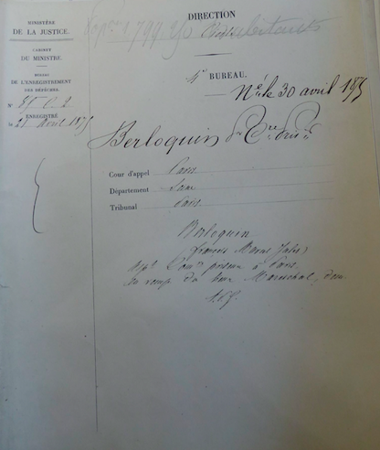
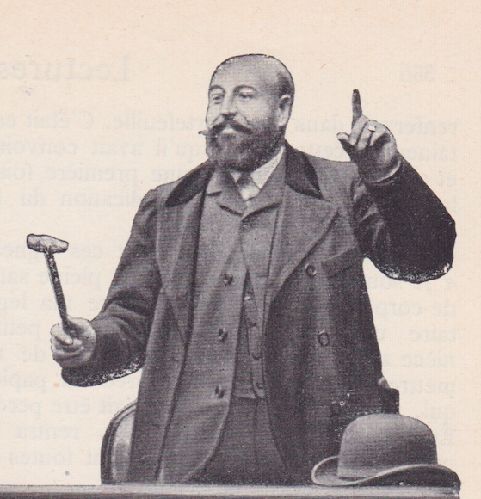
Some examples:
Nomination files of the Parisian auctioneers (1801-1960)
https://dataverse.harvard.edu/dataset.xhtml?persistentId=doi:10.7910/DVN/H8QWBW

Slide 21
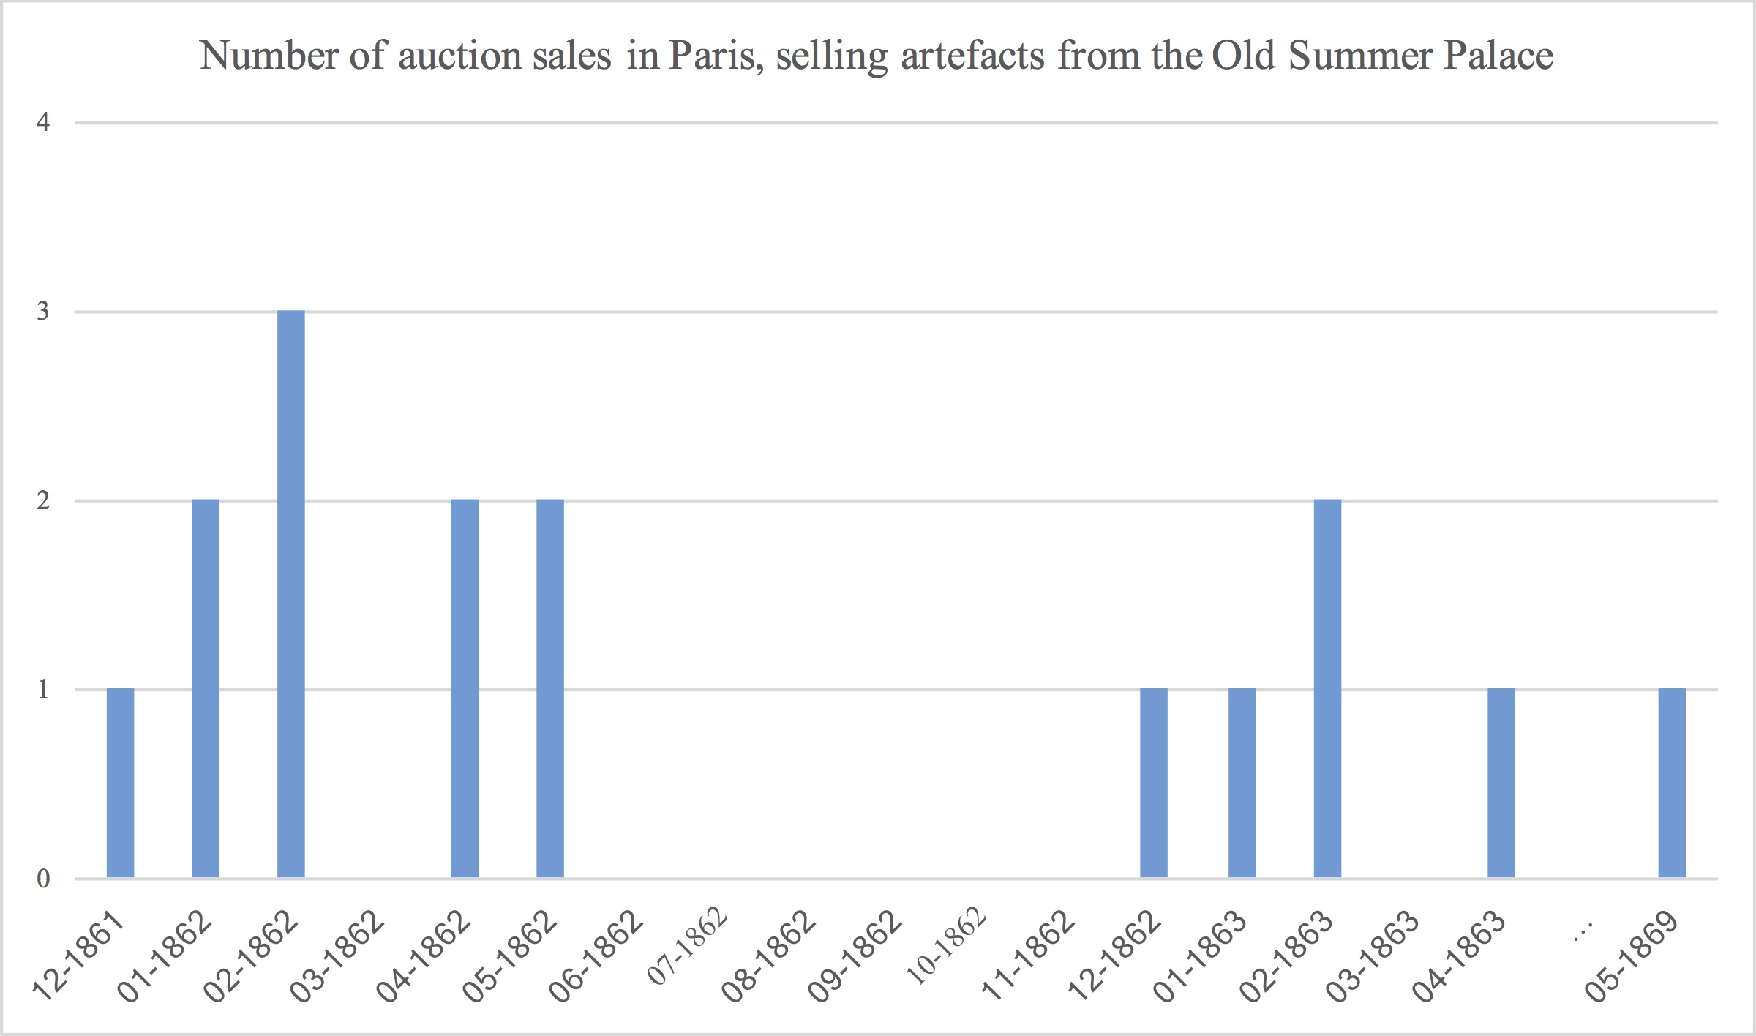
Some examples:
Parisian auction sales of artefacts from the Yuanmingyuan
https://dataverse.harvard.edu/dataset.xhtml?persistentId=doi:10.7910/DVN/0COI5J

Slide 22
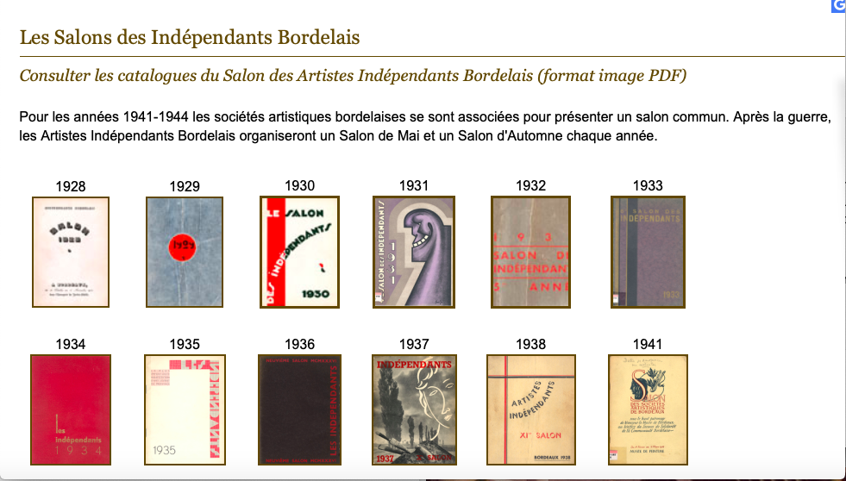
Some examples:
The Exhibitions of the « Artistes indépendants Bordelais » (1928-1949)
http://www.musba-bordeaux.fr/fr/article/salons-independants-bordelais

Slide 23
Once you have identified your closed corpus, you must transform it into an intelligent and manageable database

Slide 24
B. Network analysis

Slide 25
A
B
C
The points A, B and C are called nodes or vertices.
The segments between the vertices are called links.
Here, A is linked to B and C, but B is not linked to C.
The link can be a link of inter-knowledge (A knows B and C, but B and C do not know each other), a link of belonging (A and B have exhibited together, A and C have exhibited together, but B and C have never appeared in the same exhibition), etc.

Slide 26
A
B
C
Network density: number of links compared to the total number of possible links. (here, it is 2/3).
Degree centrality: depends on the number of links that the individual-vertex has. (here, A is more central than B and C, with 2 links instead of 1).
Connectedness of the network: depends on whether the individuals are connected or not by at least one path. A connected component is a set of vertices linked together by an unbroken chain. The number of components of a network reflects its greater or lesser fragmentation into isolated subgroups (cliques).

Slide 27
A
B
C
Citation network: This is a directed network, where the links are arrows.
B quotes A, A quotes C and C quotes A.

Slide 28
A
B
C
Citation network: This is a directed network, where the links are arrows.
B quotes A, A quotes C and C quotes A.

Slide 29
Notre base de données (2 820 lignes) :
The network can be made more complex by adding attributes to the links.
A
B
C
Number of joint exhibitions:
A and B were exhibited together in three exhibitions, A and C in one exhibition, and B and C were never exhibited together.
1
3

Slide 30
The network can be made more complex by adding attributes to the vertices.
A
B
C
Wage in euros:
The structure of the network is the same, I just added information about the individuals-vertices.
10 000
2 000
1 000

Slide 31
The network can be made more complex by adding attributes to the vertices.
D
A
B
C
Auctioneer
Here, I have colored the vertex according to the individual's profession. Expert B worked with auctioneers A and D, and writer C only worked with A.
Expert
Critic

Slide 32
How to structure the input file:

Slide 33
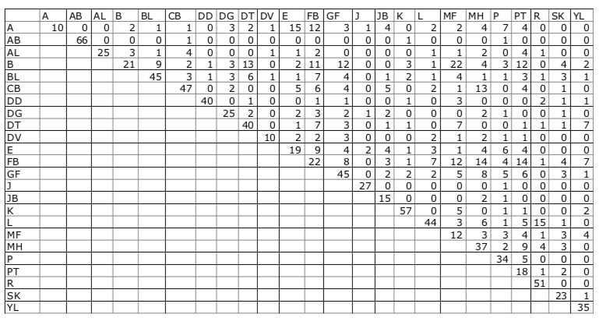
Option #1 : link matrix (vertices are in rows and columns)

Slide 34

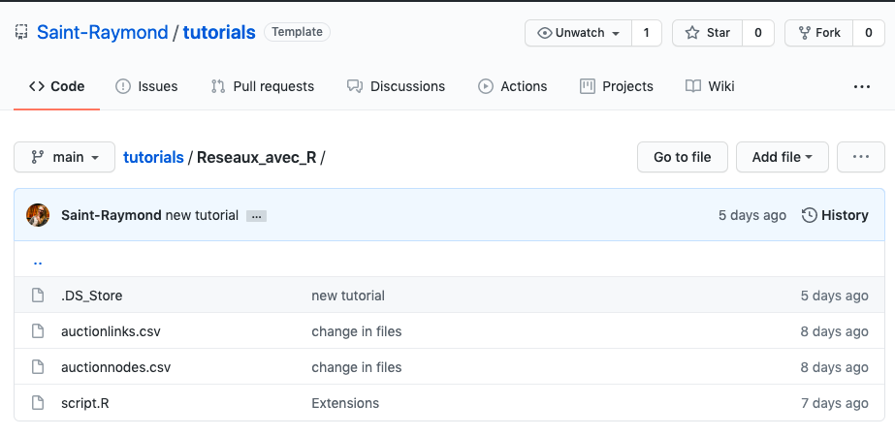
How to visualize networks with R software:
Une source bien pratique :
le Bottin du commerce
https://github.com/Saint-Raymond/tutorials/tree/main/Reseaux_avec_R

Slide 35
library("igraph")
# I need a csv file with the names (and attributes, if any) of my vertices:
nodes <- read.csv2( »path_to_my_csv", header=T, as.is=T)
# I open the csv file with the links (written with Option #3, bipartite)
links <- read.csv2("./auctionlinks.csv", header=T, as.is=T)
# I build the network:
net <- graph_from_data_frame(d=links, vertices=nodes, directed=T)
plot(net)
# For more information, see the script in the Github repository.

Slide 36

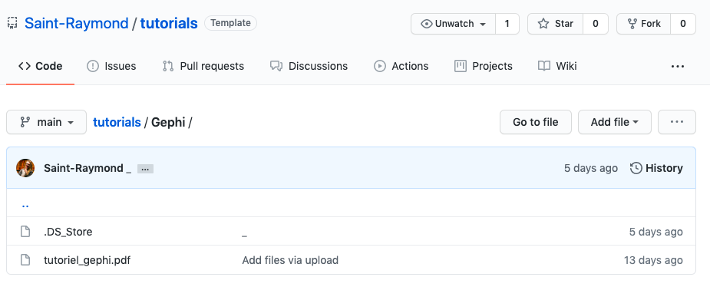
How to visualize networks with Gephi:
Une source bien pratique :
le Bottin du commerce
https://github.com/Saint-Raymond/tutorials/tree/main/Gephi

Slide 37
C. Phylogenetic networks

Slide 38
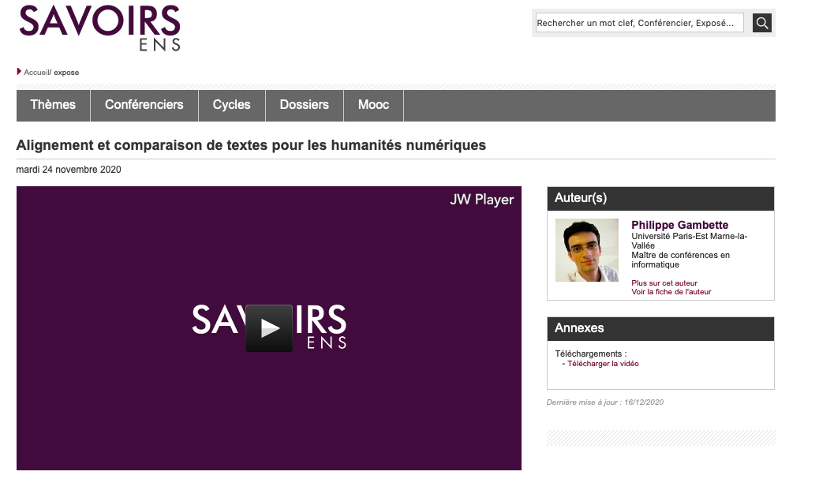
See Philippe Gambette’s conference at the DHAI seminar:
https://savoirs.ens.fr/expose.php?id=3912
Notes:
L

Slide 39
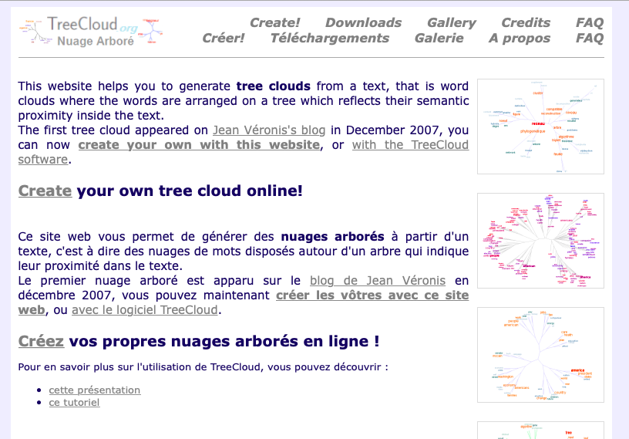
http://treecloud.univ-mlv.fr
Notes:
L

Slide 40
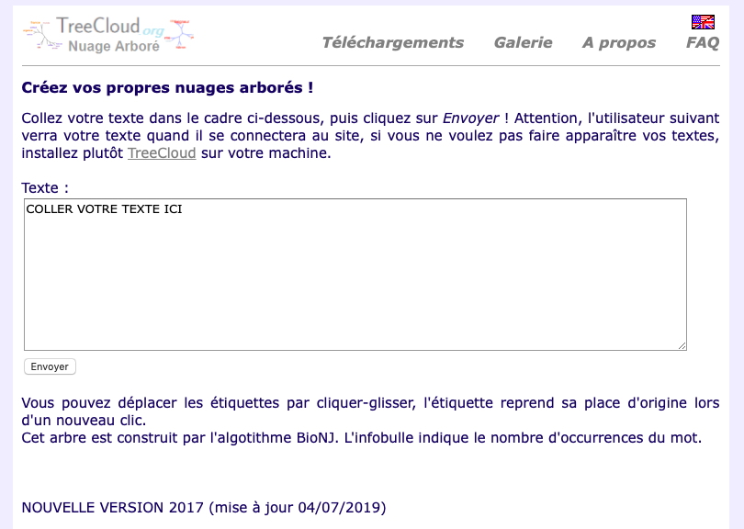
Notes:
L

Slide 41
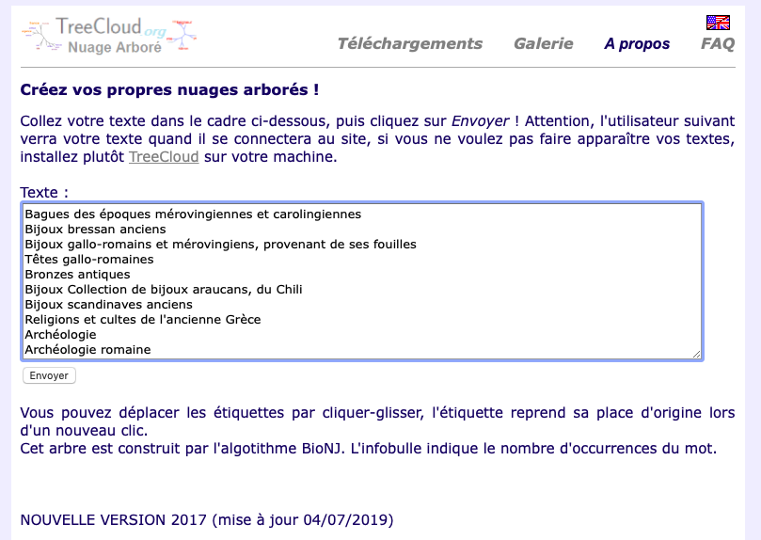
Notes:
L

Slide 42
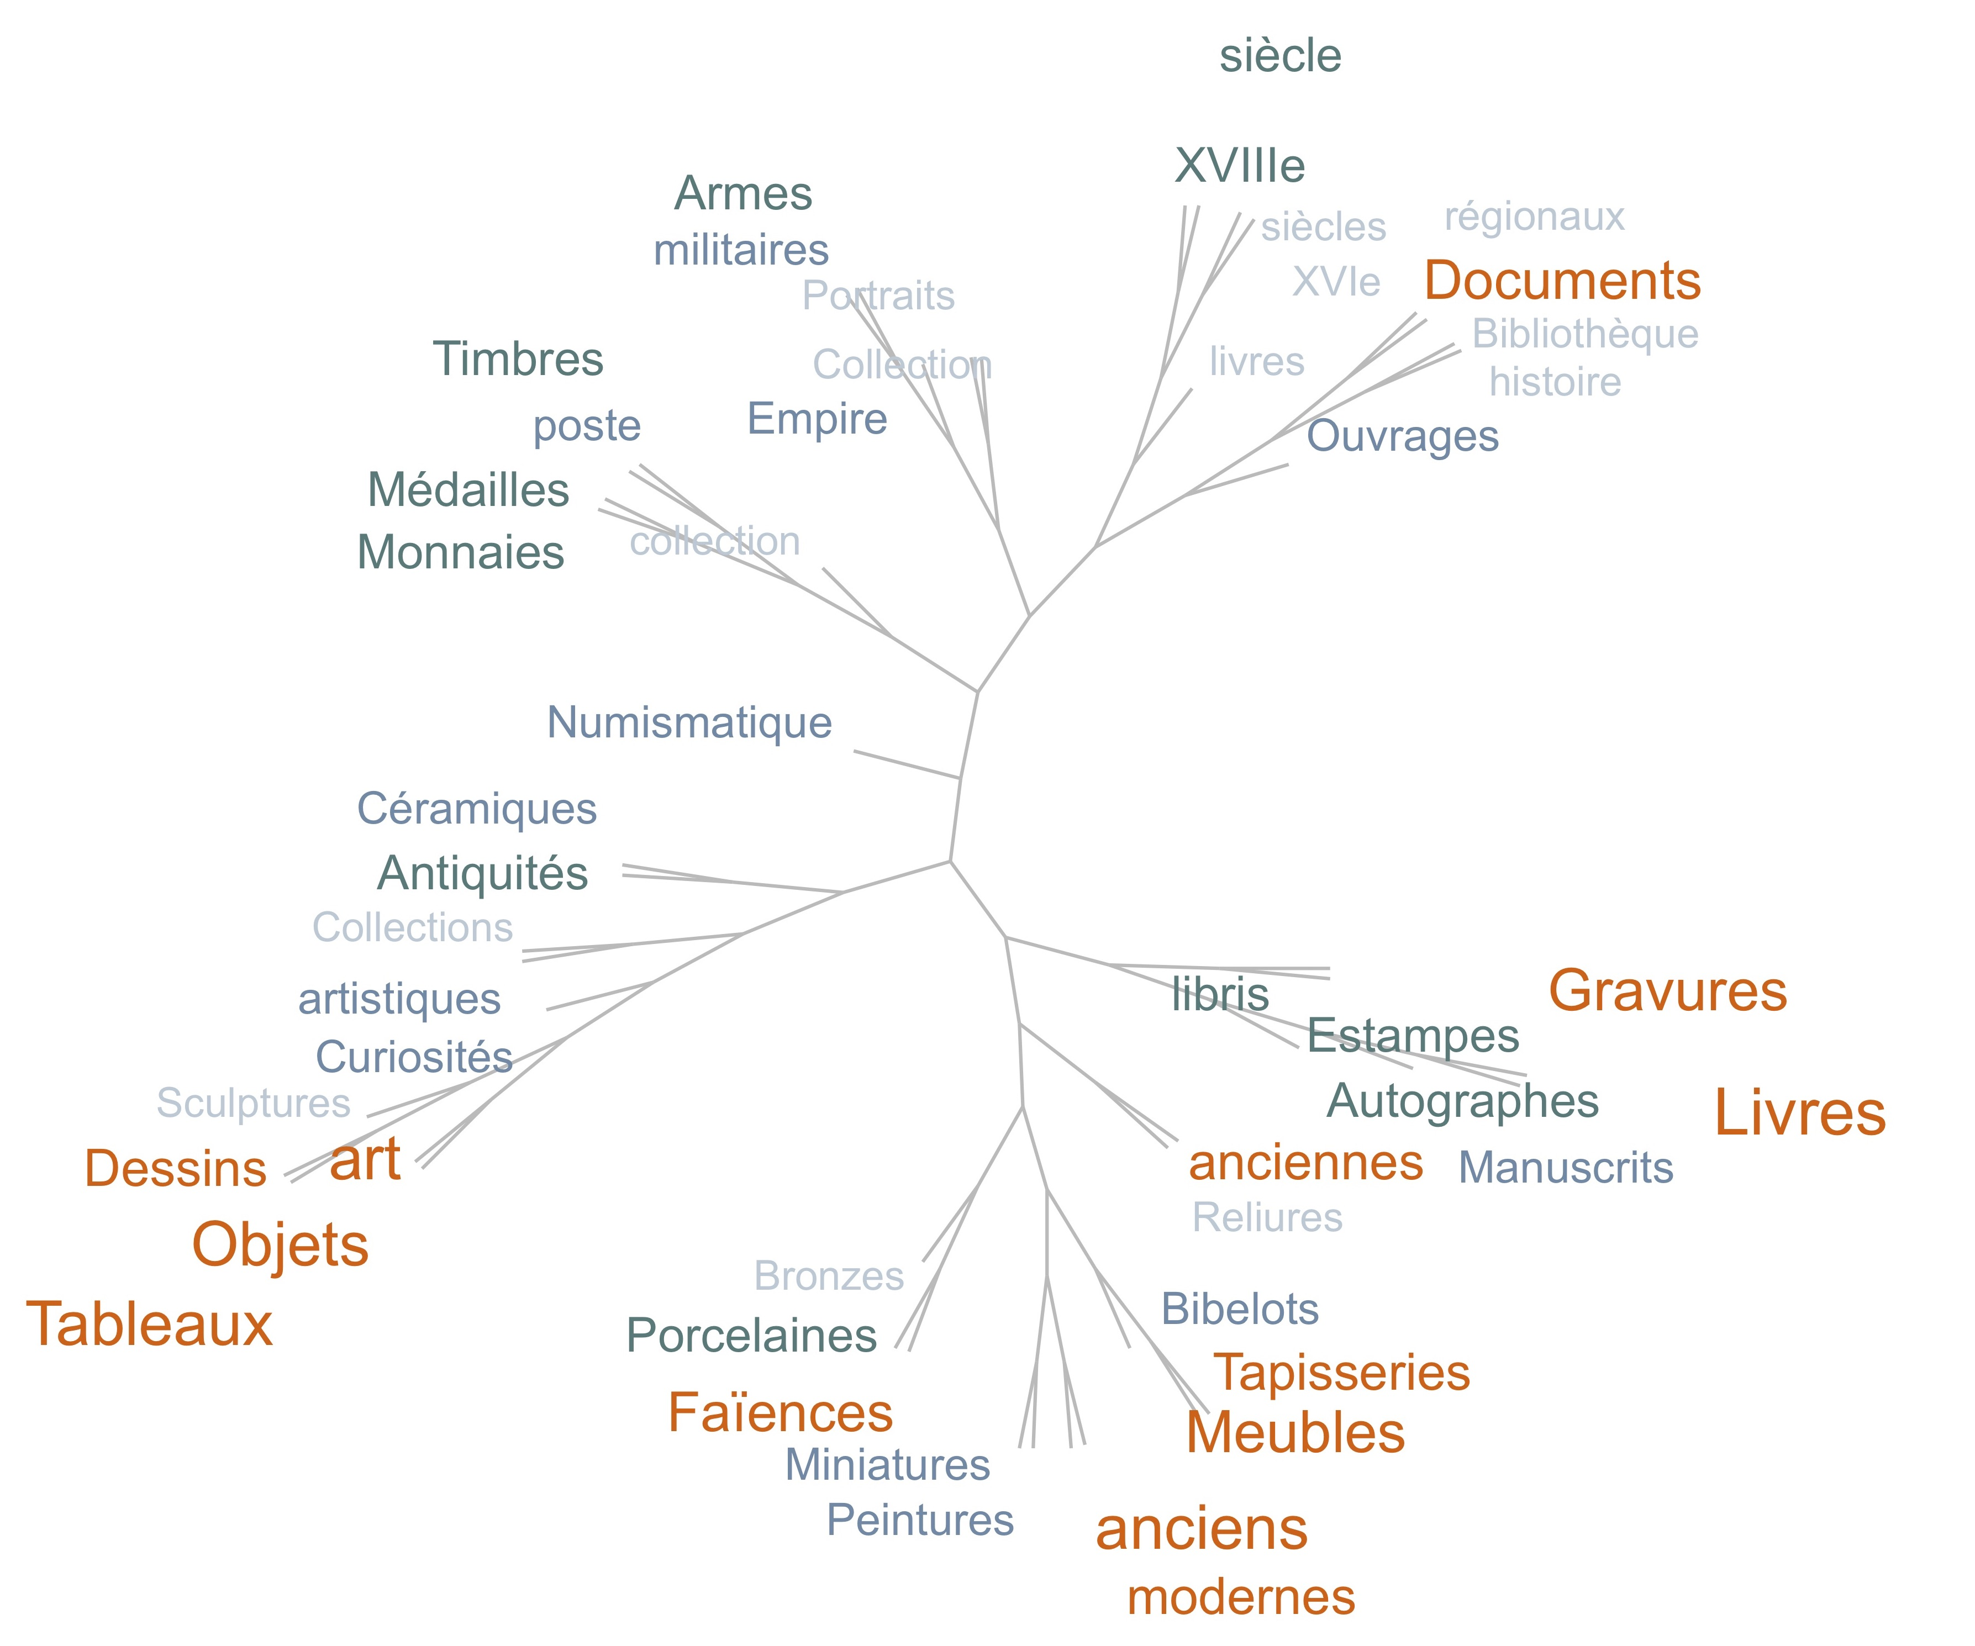

Slide 43
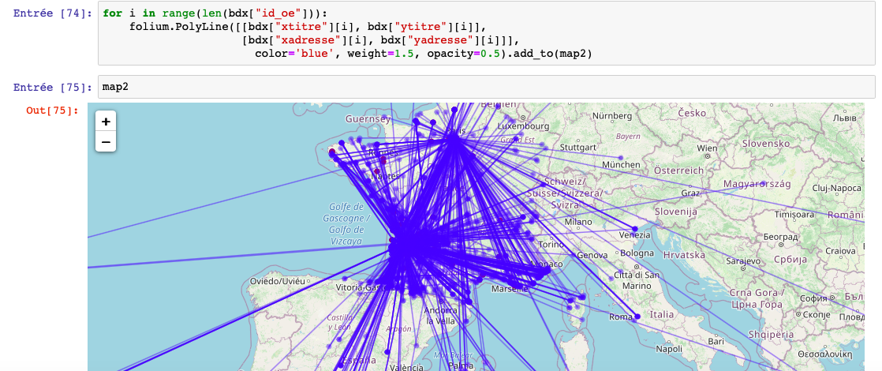
Conclusive remarks: #1 The best is the enemy of the good.
(especially when you plot a network on a map)
Most of the visualizations are unusable. ➔ ➔ ➔ ➔

